Slide 1



Spell Runner - Wizard VR
Software Engineering Department Braude College of Engineering
Capstone Project Phase A – 61998
24-1-D-37
Advisor:
PhD. Sulamy Moshe - MosheSu@braude.ac.il
Students:
Habib Ibrahim - Habib.Ibrahim@e.braude.ac.il
Vitaly Rofman - Vitaly.Rofman@e.braude.ac.il

Slide 2





Market supply
Games today use standard methods and do not use personalized/unique game features.
All players should stick to one way of playing, which can be confusing for some players.
Players may feel disconnected from the game.

Slide 3




What we offer
Prediction using ML
Individual
personalization
Designed for VR

Slide 4

Background

Slide 5
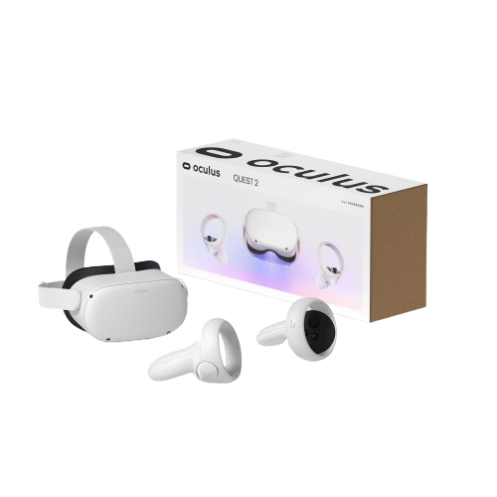


Technologies used
VR
Unity Game Engine
Machine Learning

Slide 6

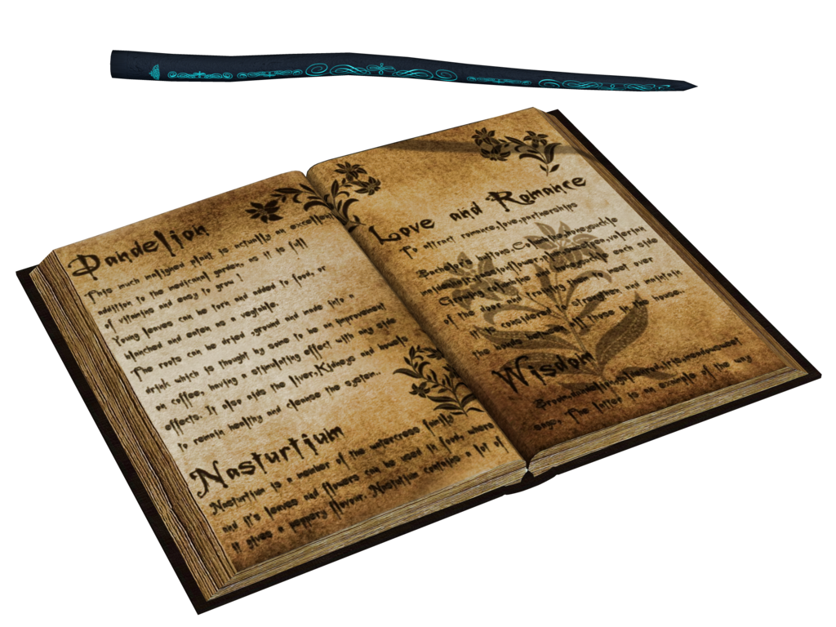
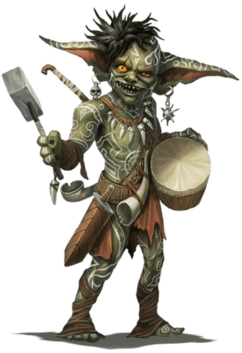
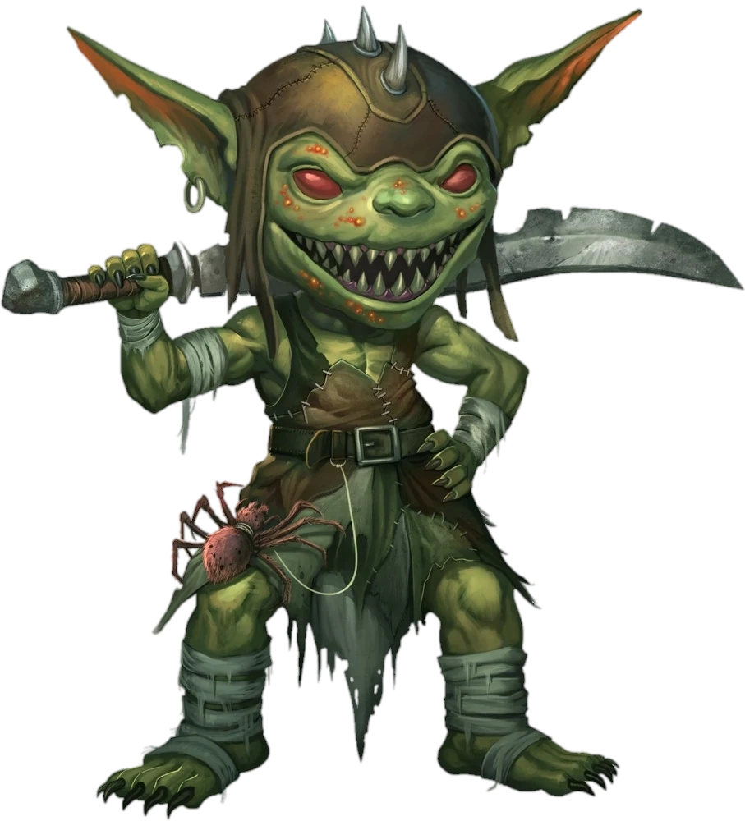
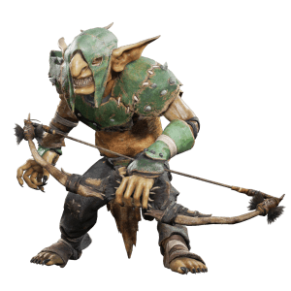
Gameplay overview
The main idea of the game is to survive a certain number of waves of enemies.
Players have a spellbook and a wand.
Players must cast spells to defend themselves and attack their enemies.
There are different types of enemies, such as :
Melee(moving towards the player), Ranged(bow with arrows), Spawners(spawning enemies).

Slide 7
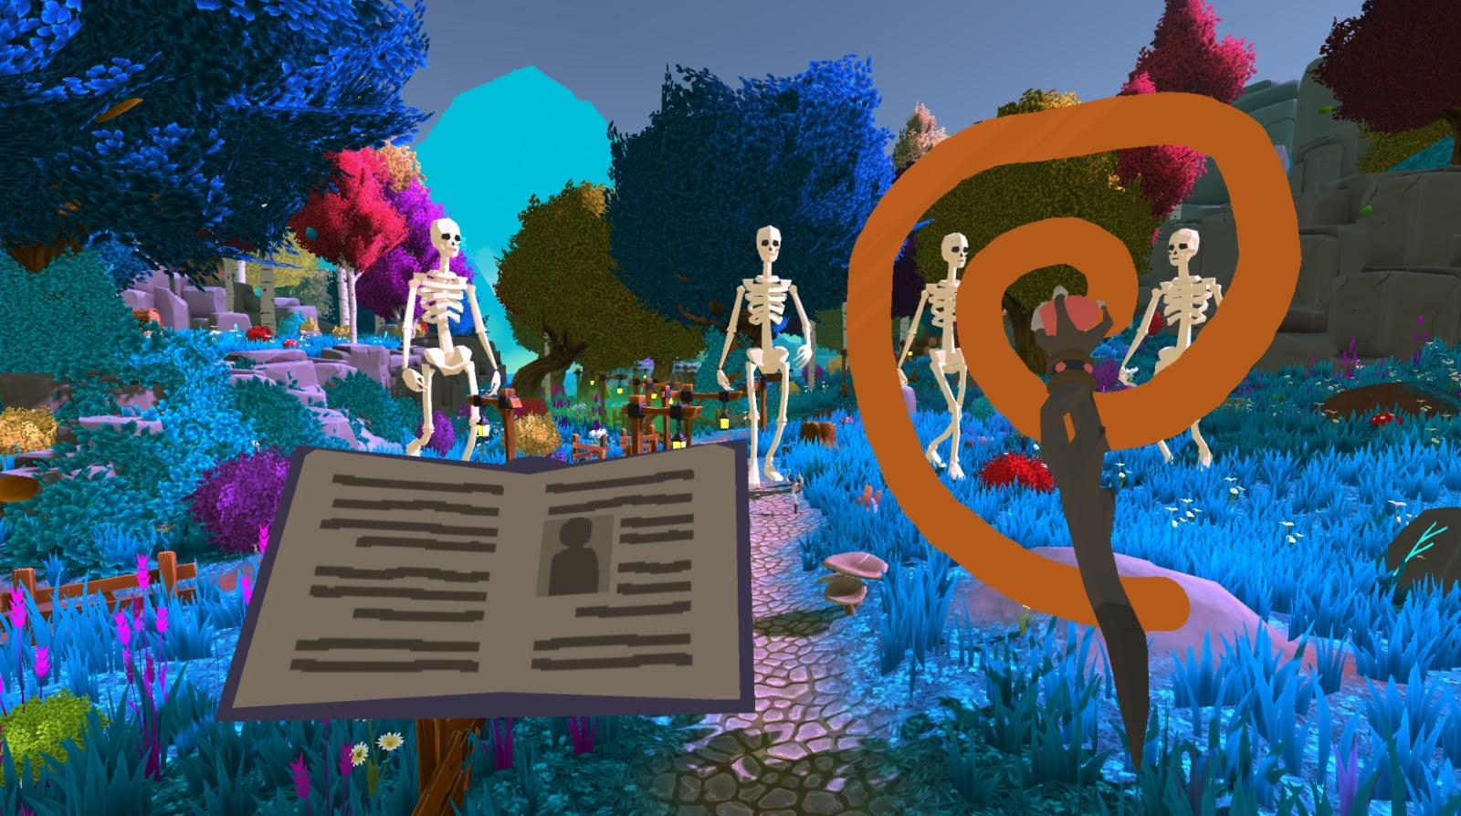
How spells will be captured?
Player presses a button then start drawing.
game creates a dynamically 3D square.
Adjusting the size to fit the drawing.
Drawing is projected to 2D.

Slide 8
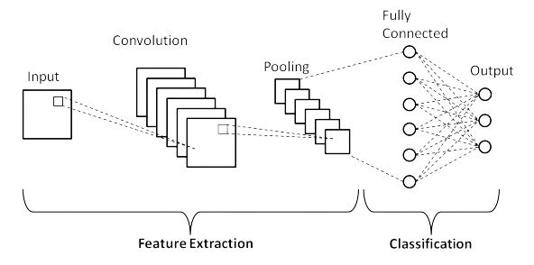

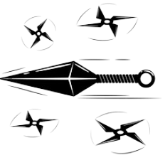
Convolutional Neural Network
sample input

Slide 9



Example 1
Player 1
Player 2
Player 3
Player 4
Accuracy = 0.942
Accuracy = 0.975
Accuracy = 0.931
Accuracy = 0.895

Slide 10

Example 2
Player 1
Player 2
Player 3
Accuracy > 0.9
Accuracy < 0.9
Spell not recognized,
Please draw a new spell

Slide 11
Process and Product

Slide 12
Personalization of the game
Default Model
After 15 drawings
After 5 drawings
Accuracy = 0.673
Accuracy = 0.721
Accuracy = 0.915
A New player starts the game with default model.
As the player plays more, the model will adapt its drawing style by updating the network weights based on new input.
We expect to improve player experience and performance.

Slide 13
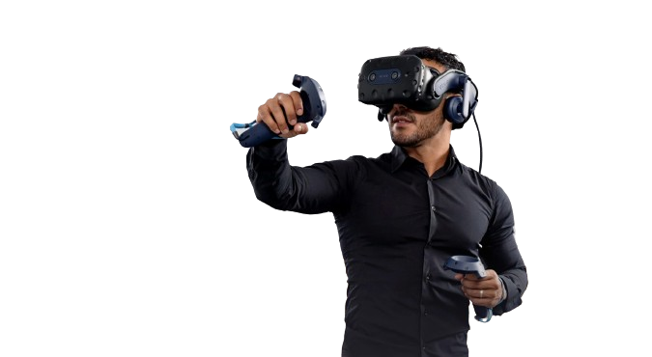
Requirements
# | FR | NFR
1 | The system must be responsive | The game should maintain stable performance
2 | The system graphics must suite for virtual environment | The game should have minimal loading times between scenes
3 | The system learns the players drawing patterns | The game interface should be user friendly and easy to understand
4 | The system predicts different spell shapes correctly | The game should be challenging.

Slide 14
Architecture overview

Slide 15

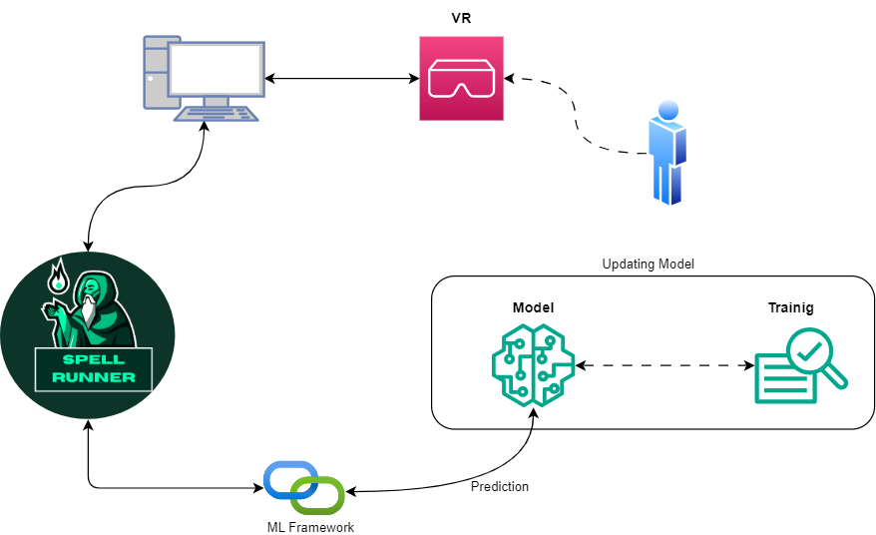

Slide 16
Screens and Flow

Slide 17
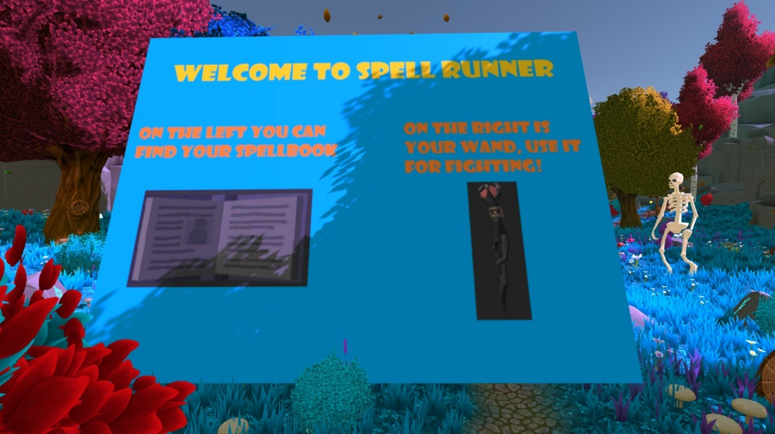

Slide 18
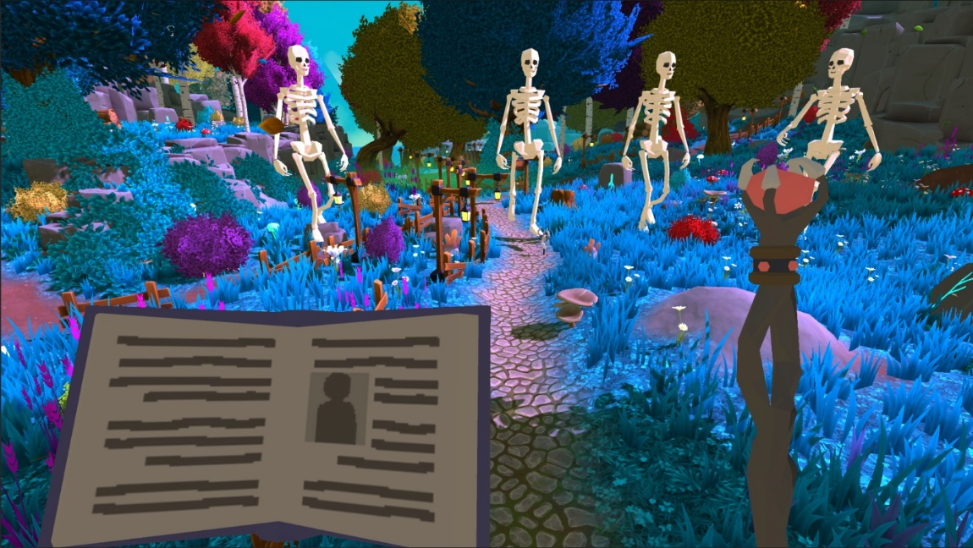

Slide 20
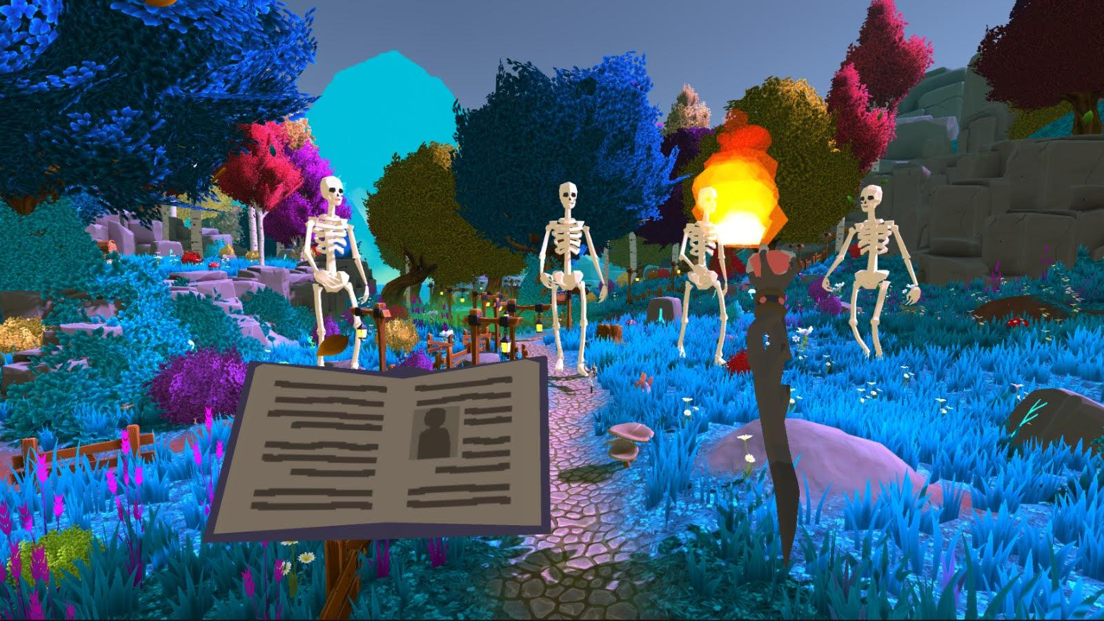

Slide 21
Activity Diagram

Slide 22
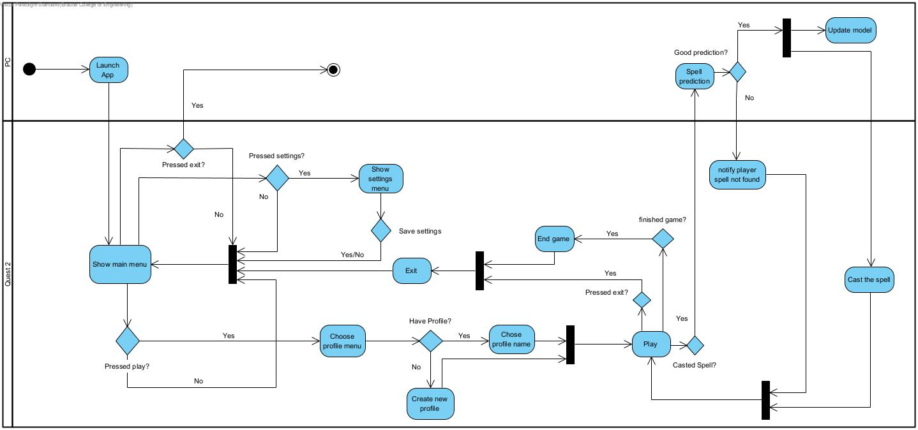

Slide 23
Test Cases
Test no. | Module | Tested Function | Expected Result
1 | Player Controller | MovePlayer(direction) | Verifies that the player character moves in the correct direction when the MovePlayer function is called with a specified direction vector.
2 | EnemyAI | ChasePlayer(playerPosition) | Tests if the enemy AI properly follows and chases the player character when given the player's current position as a parameter.
3 | Game Manager | StartGame() | Ensures that the game initializes correctly and begins running when the StartGame function is called, initializing game elements such as player health, score, and enemy spawn points.
4 | SpellCastingSystem | CastSpell(spell) | Validates that the player can cast spells of different types (e.g., fireball, lightning bolt) and that the appropriate spell effect is triggered when the CastSpell function is invoked.
5 | UIManager | DisplayGameOverScreen() | Checks if the game over screen is correctly displayed when the player character's health reaches zero, providing options to restart the game or return to the main menu.
6 | SoundManager | PlaySoundEffect(sound) | Tests whether sound effects are played correctly in the game when triggered by specific events, such as player actions or enemy encounters.
7 | MLModelProcessor | ProcessImage(image) | This test unit verifies the MLModelProcessor's ability to correctly process an input image and return the predicted result

Slide 24
Criteria for success
Responsive Interface
Technical Stability
Engaging Gameplay
Clear Goals
Model Efficiency

Slide 25
THANK YOU!

Slide 26
REFRENCES
[1] Bakkes, S., Tan, C.T. and Pisan, Y., 2012, July. Personalised gaming: a motivation and overview of literature. In Proceedings of the 8th Australasian Conference on Interactive Entertainment: Playing the System (pp. 1-10).
[2] D. Charles, M. McNeill, M. McAlister, M. Black, A. Moore, K. Stringer, J. Kucklich, and A. Kerr. Player-centered design: Player modeling and adaptive digital games. In DiGRA, pages 285–298, 2005.
[3] M. Riedl. Scalable personalization of interactive experiences through creative automation. Computers in Entertainment (CIE), 8(4):26, 2010. [4] Bakkes, S., Whiteson, S., Li, G., Vişniuc, G.V., Charitos, E., Heijne, N. and Swellengrebel, A., 2014, October. Challenge balancing for personalised game spaces. In 2014 IEEE Games Media Entertainment (pp. 1-8). IEEE.
[5] https://www.britannica.com/technology/virtual-reality
[6] https://www.meta.com/quest
[7] https://www.ibm.com/topics/machine-learning
[8] https://www.tensorflow.org/tutorials/images/cnn

